Slide 1

FLIGHT ACADEMY PORTAL
Section – 2
J Amrutha_2520080066
N Charishma_2520090214

Slide 2
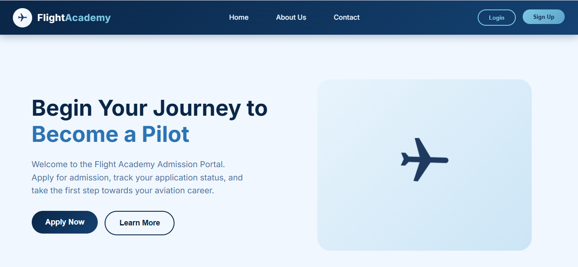

Slide 3
INTRODUCTION
Flight Academy Portal is a web application for managing flight academy admissions.
It provides students with an easy way to register and apply online.
The portal simplifies the admission process and improves accessibility.

Slide 4
PROBLEM STATEMENT
Manual admission processes require more time and effort.
Students find it difficult to track application status.
Managing records manually can lead to errors.

Slide 5
OBJECTIVES
Provide online registration facility.
Enable secure login system.
Simplify admission application process.
Allow students to track application status.

Slide 6
TECHNOLOGIES USED
Frontend
React.js
JavaScript
HTML
CSS
Development Tool
Vite
Routing
React Router DOM

Slide 7
SYSTEM ARCHITECTURE
User ↓ Registration ↓ Login ↓ Dashboard ↓ Application Submission ↓ Test Scheduling ↓ Status Tracking

Slide 8
MAIN MODULES
Home Page
Displays academy information
Provides navigation to portal features
User Authentication
User Registration
Secure Login System
Dashboard
Centralized user panel
Access to applications and services

Slide 9
Application Management
Admission application submission
Application status tracking
Test Scheduling
Test slot booking
Schedule management

Slide 10
KEY FEATURES & ADVANTAGES
Features
Easy Registration
Secure Login
Application Submission
Test Scheduling
Status Tracking
Advantages
Saves Time
Reduces Paperwork
Easy Accessibility
User-Friendly Interface

Slide 11
CONCLUSION
Flight Academy Portal provides a modern solution for admission management.
The system simplifies registration, application, and test scheduling.
It improves efficiency and enhances user experience.
Future Scope
Database Integration
Email Notifications
Online Payment Gateway
Admin Dashboard

